Slide 1

Capstone Project Total Soccer Analysis
Student Name :Asher C ALEXANDER
Mentor Name: Jaya Pandey

Slide 2
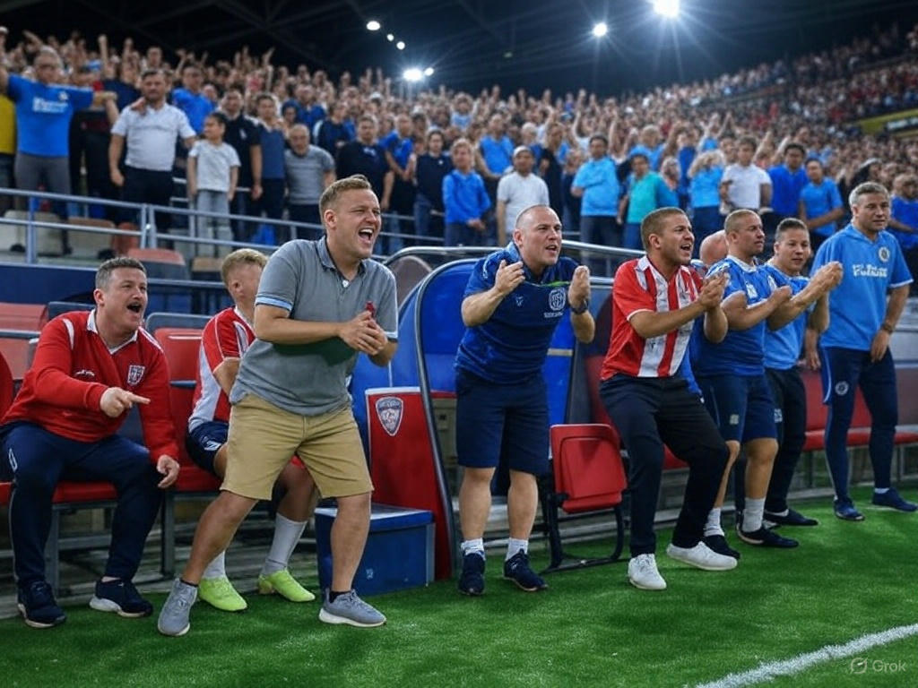
Introduction
Soccer offers vast data that can enhance strategic decisions for clubs and analysts.
This project uses a rich dataset covering player performance, match details, demographics, and financials.
Using techniques like descriptive analytics, visualization, hypothesis testing, and machine learning (logistic regression, KNN, K-means, linear regression),
we analyze key areas such as player performance, market value, team comparisons, attendance trends, referee patterns, substitutions, game events, competition dynamics, and contracts.

Slide 3
Project Outline
Core Objectives
Tools and Techniques
Phase 1: Data Cleaning and Pre-processing
Phase 2: Analysis
Summary
Conclusion

Slide 4

Core Objectives
1. Performance Analysis
2. Player Profile and Market Value
3. Team Comparison
4. Attendance and Stadium Analysis
5. Referee Analysis,
6. Substitution Patterns,
7.Event Analysis
8. Competition Analysis
9. Player Attributes and Demographics
10. Contract Management

Slide 5


Tools and Techniques
Jupyter Notebook: Statistical Techniques ,Machine Leaning model,Descriptive analytics
Tableau: Analytics and Visualization

Slide 6
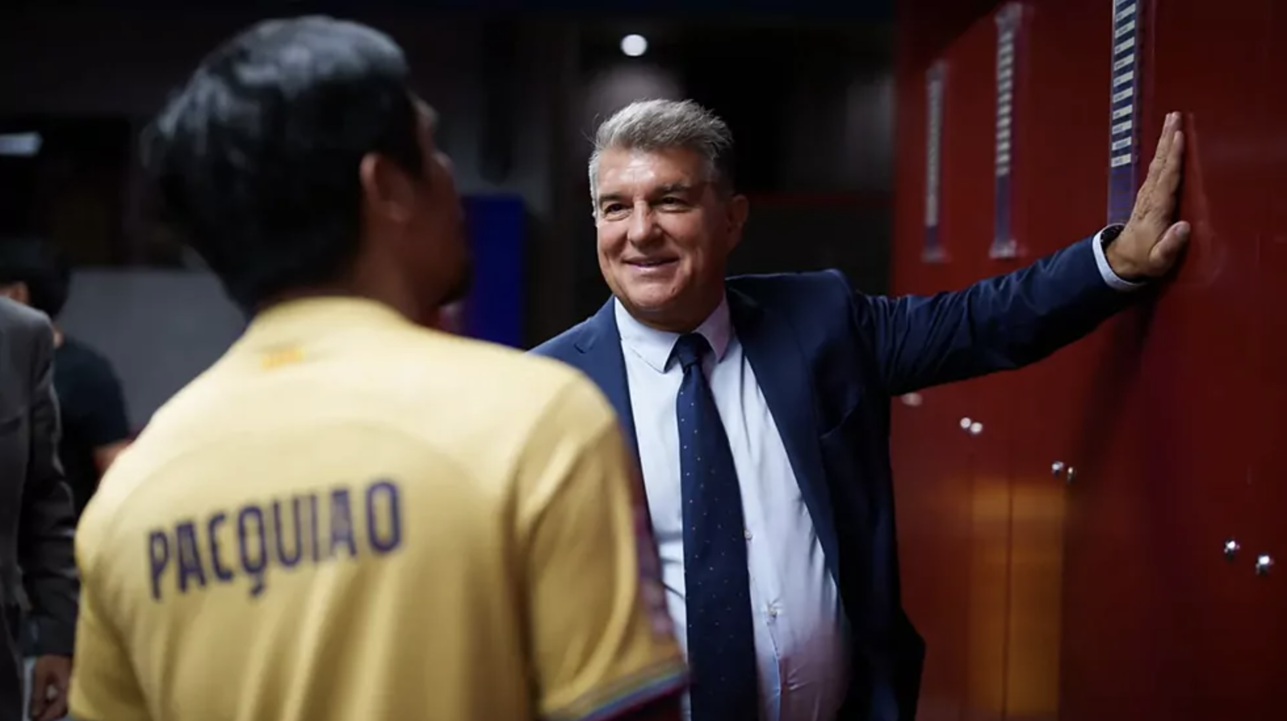
Phase 1: Data Cleaning and Pre-processing
We imported a dataset and organized the five files into separate folders (variables). Each file was loaded using pandas' Excel reading function.
We checked for null values in all five folders using folder.isnull().sum() and filled any missing values with fillna, applying mean, median, or mode based on the data type (numerical or categorical).
Columns with object data types were converted to categorical using astype('category’).
We then merged the folders based on common columns, creating a single merged folder.
Where necessary, we renamed columns, dropped irrelevant ones (e.g., 'agent name'), and exported the final merged folder as a CSV file.

Slide 7
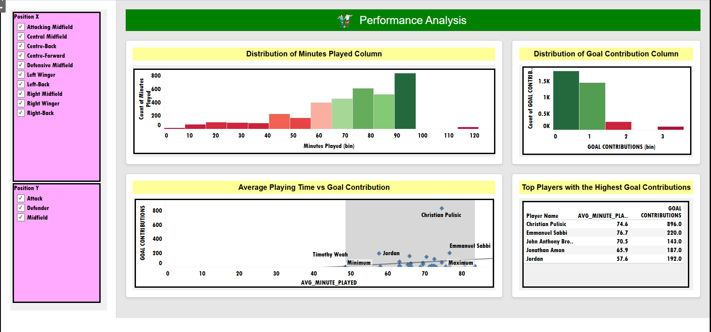
Phase 2: Analysis Core Objective 1:Performance Analysis
1.Descriptive analysis
Q) What is the relationship between average playing time and goal contribution among players, and who are the top performers based on these metrics?
Ans:
Christian Pulisic stands out as the top performer in goal contribution per minute.
Most players average 70–75 minutes per match with moderate variation.
However, goal contributions are highly skewed—the average is 0.63, but the median is 0, meaning over half didn’t contribute to any goals.
A few players dominate: only five have 100–200 goals, while most are below 100.
Both playtime and goal data are not normally distributed, highlighting that a small group has an outsized impact, led by Pulisic.

Slide 8

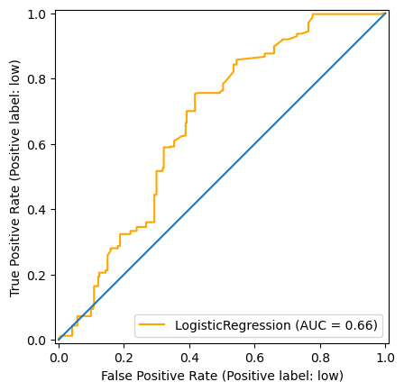
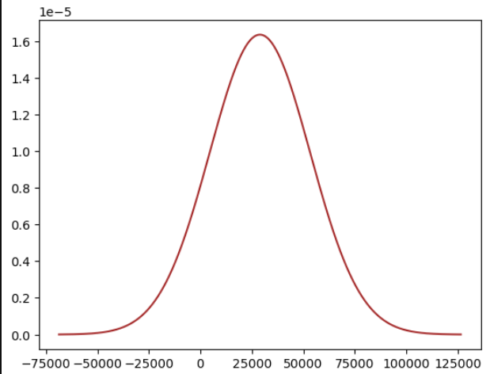
Core Objective 1:Performance Analysis ContNUE……
2. Probability
4. Logistic Regression
Q) What is the probability that a team scores more than 2 goals in a match?
Ans: The probability that a team scores more than 2 goals in a match is 1.15 %
Q) Can we classify players as ‘High’, or ‘Low’ performers using Logistic Regression based on their highest_market_value_in_eur, cards, minutes_played ?
Ans
Evaluation Metrics:
accuracy score:
0.68.precision score: 0.68,recall score: 0.65,F1 score 0.65.
model performs moderately well, but there's room for improvement, especially in recall and F1 score.
ROC Curve: ROC AUC = 0.664 means that there's a 66.4% chance that your model will rank a randomly chosen positive instance higher than a randomly chosen negative one
3. Normal distribution
Q) If we take 20 random samples of 200 matches each (with replacement) from the attendance data, what is the distribution of the sample means? Does this sampling distribution approximate a normal distribution, and how does its standard deviation compare to the population standard deviation divided by the square root of the sample size?
Ans:The distribution of the 20 sample means is roughly normal, consistent with the Central Limit Theorem (CLT). Despite the population being uniformly distributed, the large sample size (200) ensures the sample means form a bell-shaped curve. The standard deviation of the sample means closely matches the population standard deviation divided by √200, confirming the CLT.

Slide 9
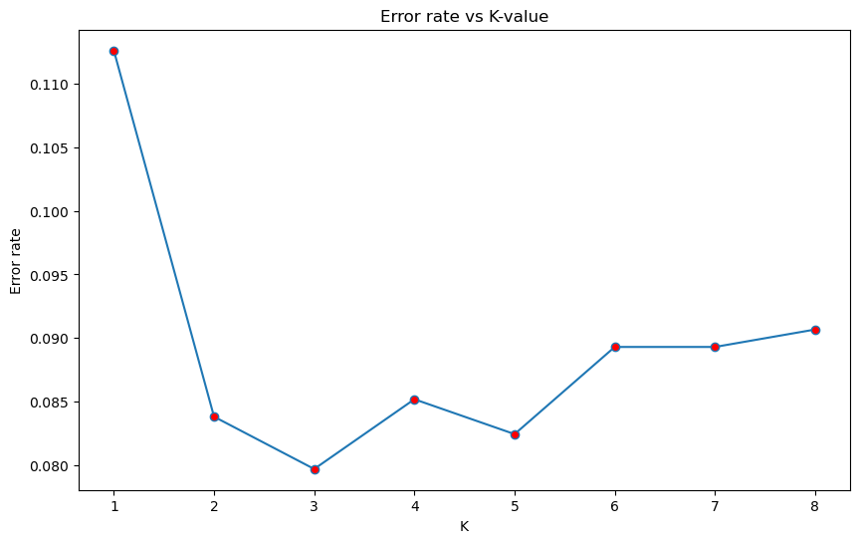
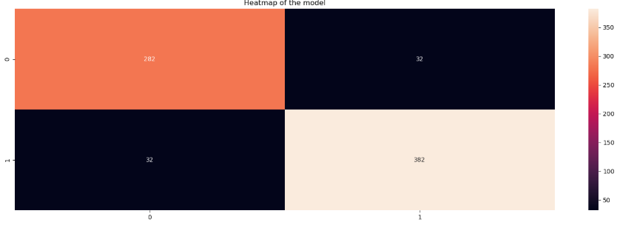
Core Objective 1:Performance Analysis ContNUE……
PREDICTIONS
Confusion Matrix:
91.2% the model has predicted well on unknown dataset.the model has incorrectly predicted 8.8% times .
suggesting that the model works well with knn than logistic regression.
Evaluation Metrics:
accuracy 0.91
recall 0.91
f1-score 0.91
Precision-score 0.91
we got a good model using knn algorithm
(WE DID IT USING KNN SINCE LOGISTIC DID NOT FIVE GOOD RESULT ) KNN:
k=3 has lowest error 0.080

Slide 10

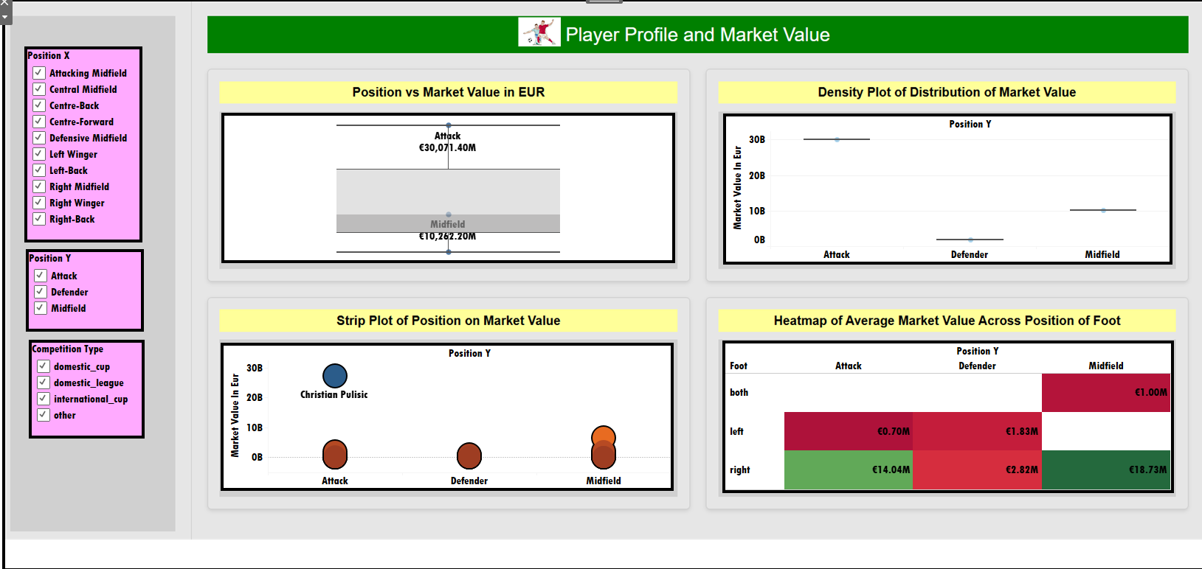
Phase 2: Analysis Core Objective 2: Player Profile and Market Value
1.Descriptive analysis
Q) How does a player's position on the field affect their market value?
1. Market Value by Position: Attackers lead (€30,071M), followed by midfielders (€10,262M), and defenders (~€1,778M).
2. Distribution: Market value is skewed toward attackers, who dominate the high-value range.
3. Outlier: Christian Pulisic stands out among attackers, boosting their overall value.
4. Footedness vs Position: Right-footed midfielders average ~€19M, while left-footed attackers show lower values—indicating individual outliers impact totals.
5. Mode: €25M is the most common market value.
6. Player Count: Attackers: 2,278; Defenders: 778; Midfielders: 581.

Slide 11
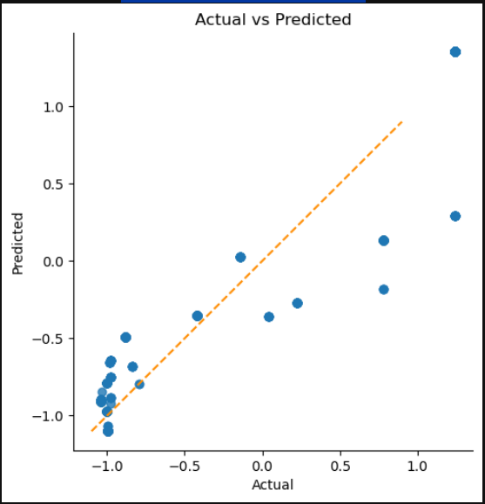
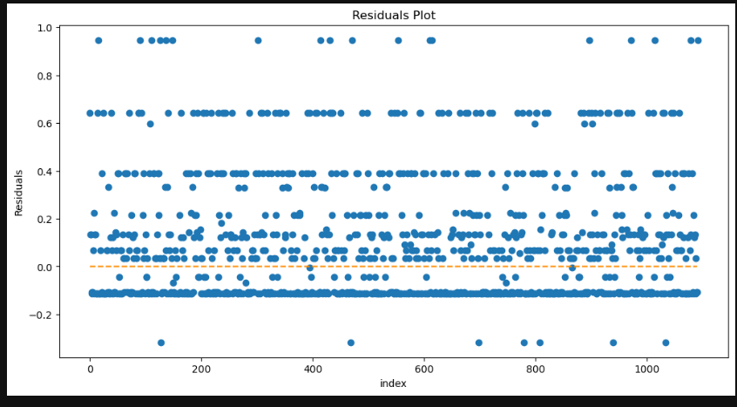
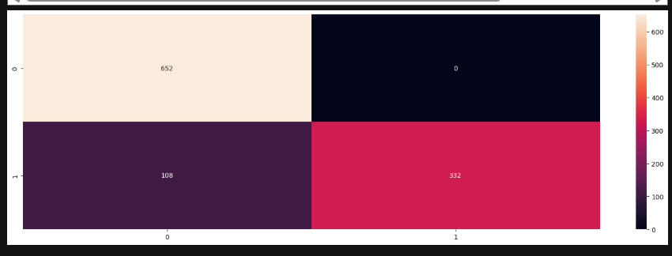
Core Objective 2: Player Profile and Market Value ContNUE……
PREDICTIONS
2) multiple linear regression
:
Which player attributes (height, age, nationality, highest_market_value_in_eur) most significantly influence current market value using multiple linear regression?
1)SCATTER PLOT:
1)FEATURE VS TARGET :THE RELATIONSHIP BETWEEN THE TARGET AND THE FEATURES
PREDICTIONS FOLLOW THE DIAGONAL LINE SHOWCASING A GOOD MODEL.
2)RESIDUAL PLOT:
they are showing a good trend linear in nature with residuals hover near zero showing that the model isn't biased.
the final equation is:
y=a+bix1+b2x2+b3x3
y= 0.0051+ 0.08058474x1+ 0.15488001x2 + 0.91634077x3¶
Evaluation Metrics:
score of trained model: 0.90,mean squared error :0.09,mean absolute error :0.21,root mean squared error :0.29,r squared value :0.91
Intepretation as we increase the feature the accuracy has increased the error rate(mse,mae,rmse) have dropped and r2_square value has increased.
Confusion Matrix:
90.17 it got right on unknown data indicating good model.

Slide 12
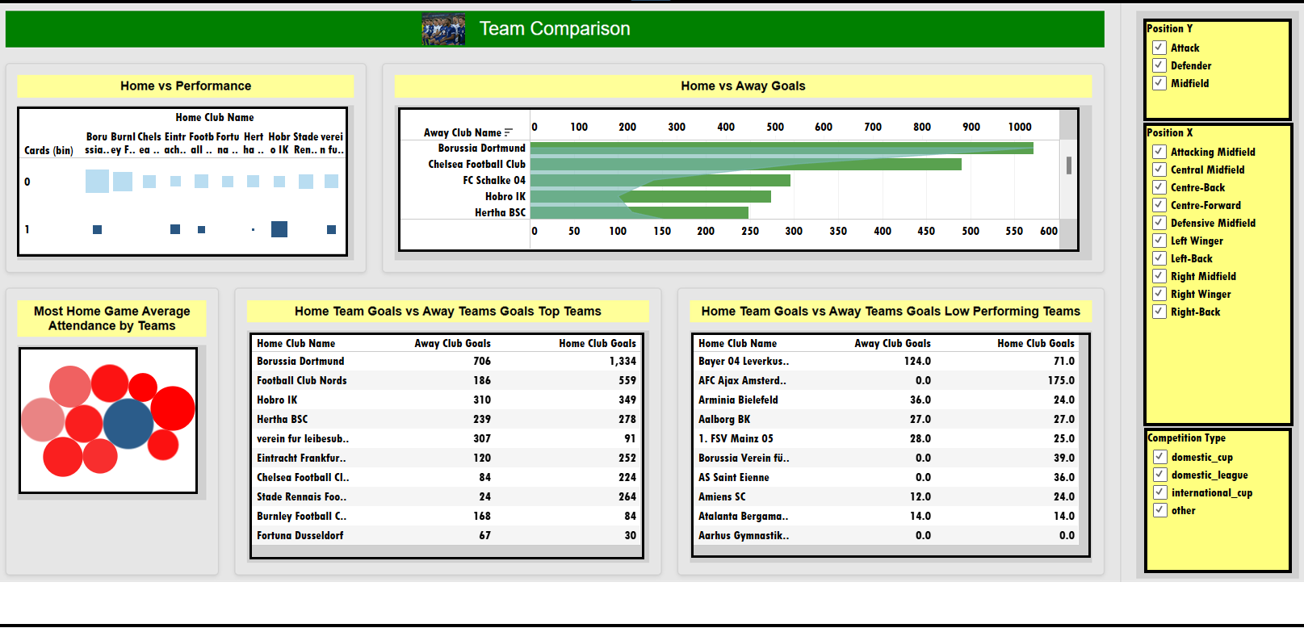
Phase 2: Analysis Core Objective 3: Team Comparison
1.Descriptive analysis
3.1 ) How do team performances differ across goals, cards, and attendance?
Ans:
Fewer cards often link to more goals; Hobro IK is an exception.
Teams score more goals at home than away.
Borussia Dortmund has the highest average home attendance (73,000).
Dortmund also leads in home and away goals.
Aarhus Gymnastik scored no goals, home or away lowest performing team.

Slide 13
Core Objective 3: Team Comparison ContNUE……
2.Hypothesis testing
Is there a statistically significant difference in the average number of goals per match between home and away teams?
A)
There is a statistically significant difference in average goals between home and away teams.

Slide 14
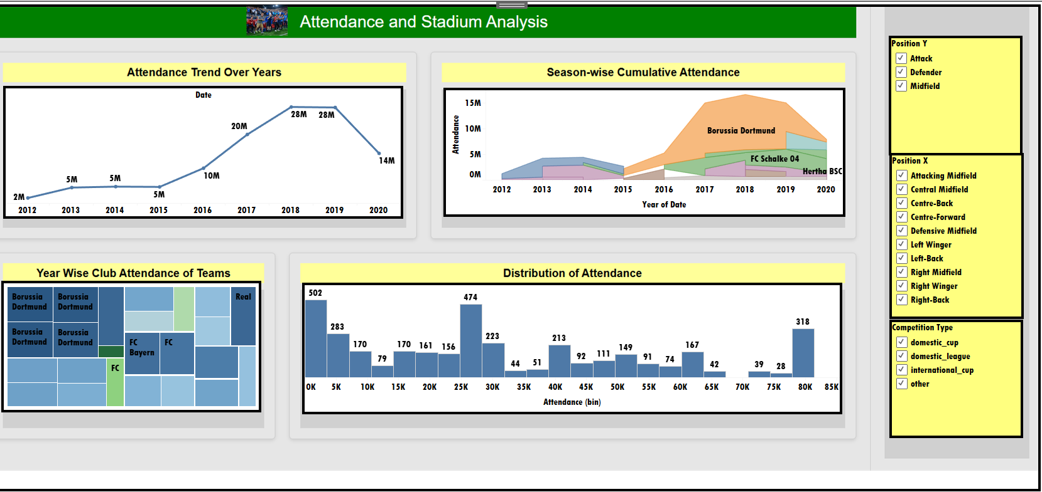
Phase 2: Analysis Core Objective 4: Attendance and Stadium Analysis
1.Descriptive analysis
q)What trends can be observed in stadium attendance over seasons?
Ans
Attendence Trend Over Years:Attendance increased steadily from 2015 to 2018, remained stable in 2019, and then declined in 2020.
Season-Wise Cumulative Attendence: Borussia Dortmund recorded the highest cumulative attendance across seasons.
Year Wise Club Attendence of Teams: Borussia Dortmund consistently leads in yearly total attendance figures.
Distribution of Attendence:The distribution is fairly good, though not perfectly normal.
'SIGNAL IDUNA PARK' is the stadium with most attendence overall.
'Ernst-Abbe-Sportfeld' is the stadium with least attendence overall.

Slide 15
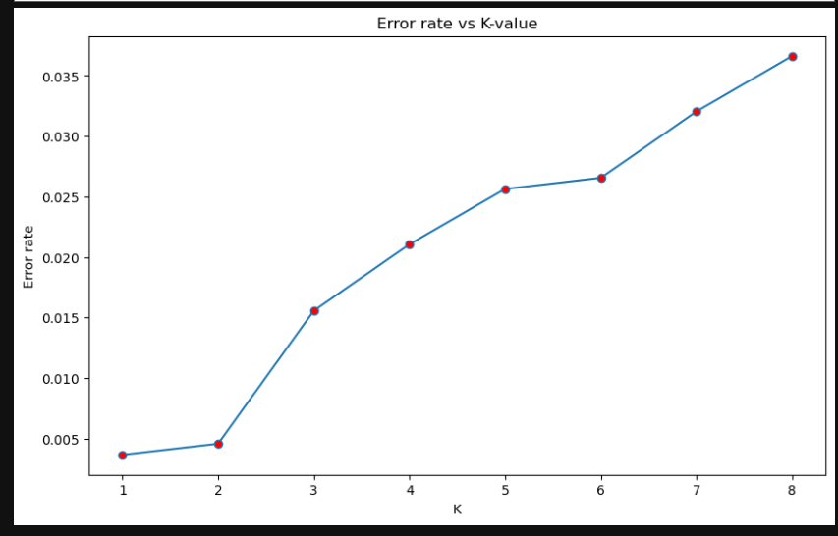
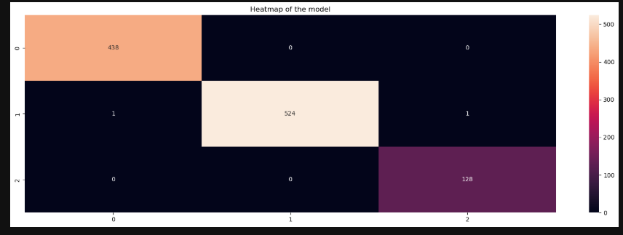
Core Objective 4: Attendance and Stadium Analysis ContNUE……
2) KNN
Q) Can KNN classification predict attendance category (e.g., High/Medium/Low) based on features like teams playing, stadium, and goals?
Error Rate Vs K Value:
since the error rate increases as the increasing k we chose 3 for better rep .
Evaluation metrics:
accuracy 0.99
recall 0.99
f1-score 0.99
Precision score 0.99
it gives good results on metrics suggesting good model.
Confusion Matrix: only 2 incorrect predictions is shown in the confusion matrix suggesting good model prediction.

Slide 16
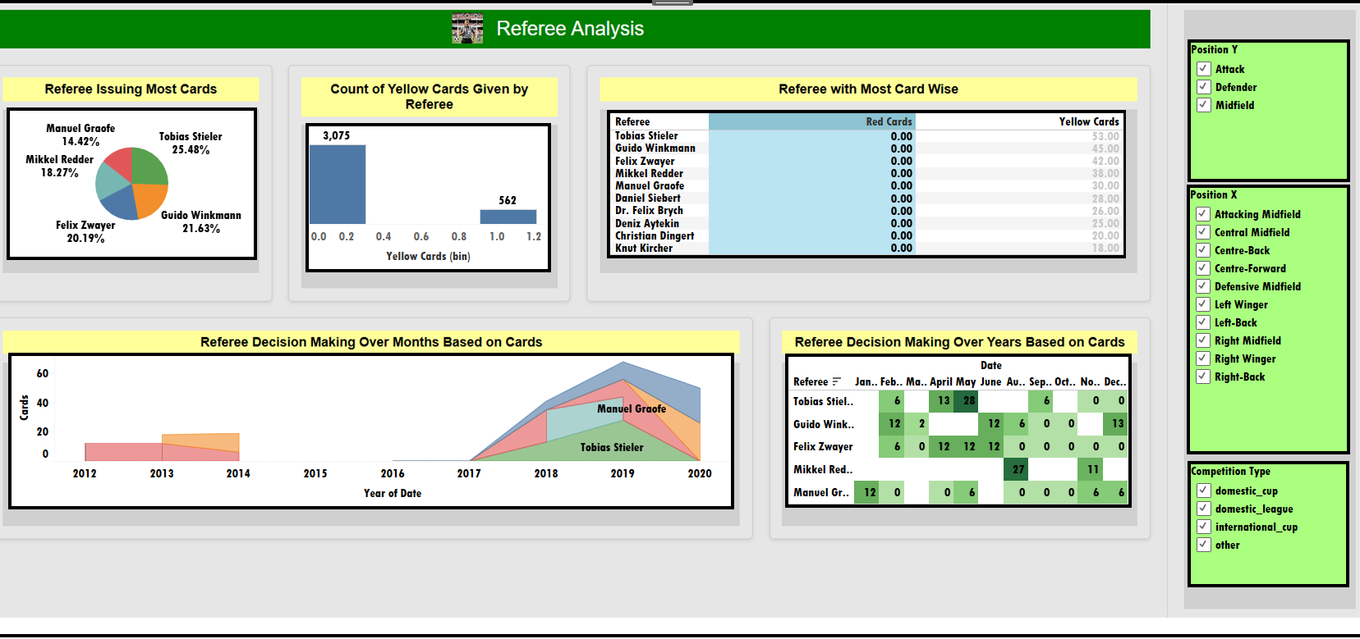
Core Objective 5: Referee Analysis
1.Descriptive analysis
5.1 Which referees tend to issue the most yellow/red cards
Ans:
Top Referee: Tobias Stieler issued the most cards, making up ~25.5% of all. Yellow Cards: No red cards were given; only five referees issued 30+ yellow cards. Overall Trend: Yellow cards are rarely issued, with most referees giving few or none.
5.2 how consistent are referees is their decision-making across seasons?
Ans:
Referee Decisions Over Years: Card issuance was low from 2012–2014 and absent from 2014–2017 among top referees. It increased notably from 2017–2020, indicating stricter discipline.
Referee Decisions by Month: No cards were given in October; March had very few (only 2), likely due to fewer matches.
Most Active Referee: Felix Zwayer had the most appearances.

Slide 17
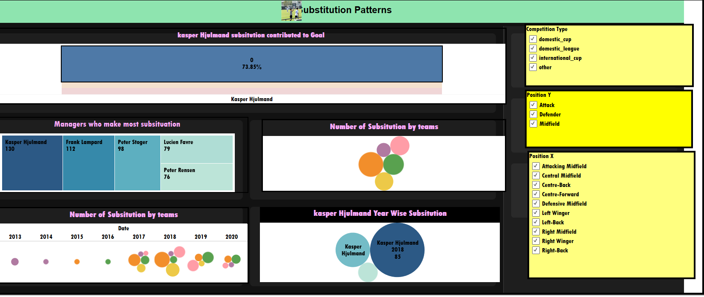
Core Objective 6: Substitution Patterns
1.Descriptive analysis
Q)Which managers substituted most frequently?
Ans:
Top Manager: Kasper Hjulmand made the most substitutions (130), with a peak in 2018 (85 substitutions).
Effectiveness: His substitutions led to goals only 26.15% of the time, with 73.85% not resulting in goals.
Q) Which game had the highest number of substitutions, at what minute do substitutions most commonly occur, and how do substitution patterns vary across different teams?
Ans :
Highest Substitutions: Game ID 4103556 had the most substitutions (74).
Substitution Timing: Most substitutions occur after halftime, especially between the 70th–80th minutes.
Top Team: Borussia Dortmund leads with 244 total substitutions.
Yearly Trend: From 2017 to 2020, substitutions increased among the top 5 teams, peaking in 2018.

Slide 18
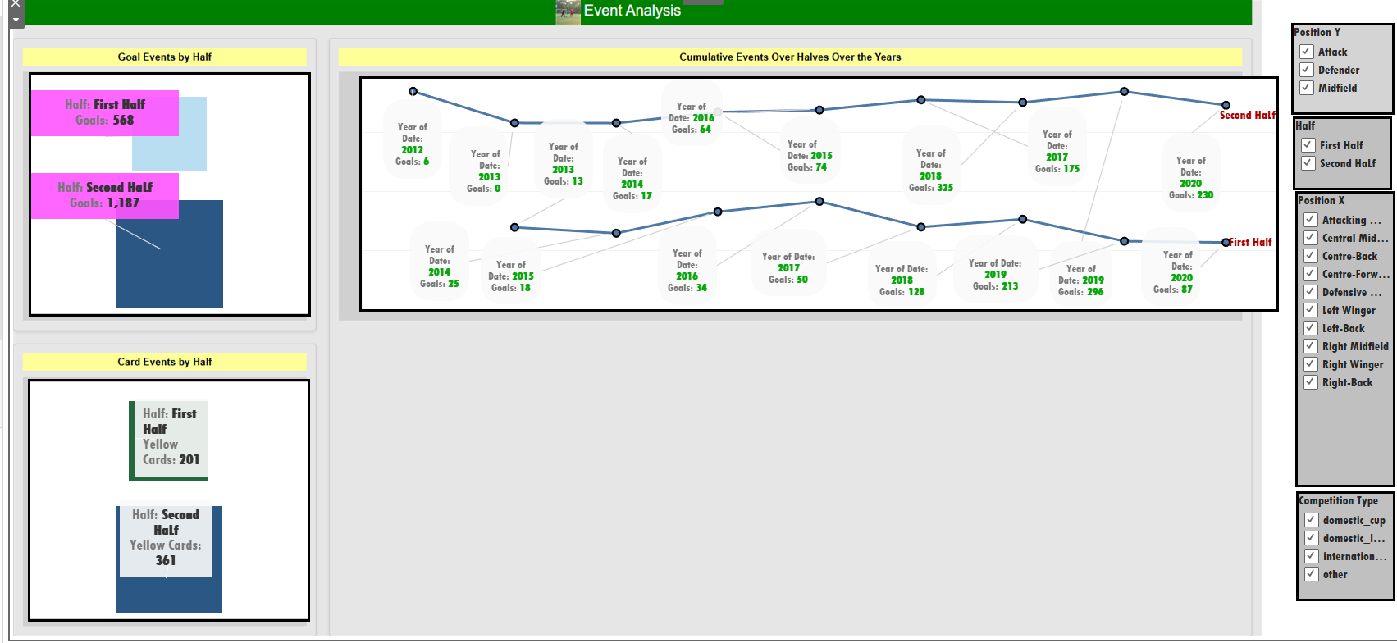
Core Objective 7: Event Analysis
2)hypothesis testing
1.Descriptive analysis
Q)How do key events like goals, cards cluster around specific minutes or halves in a match?
Ans:
Second Half Dominance: Most goals, cards, and substitutions occur in the second half. Attendance Trend: 85.03% of spectators arrive in the second half, while only 14.96% come in the first.
Q)At a 0.05 significance level, is there a statistically significant difference in the average goal involvement of away teams between the first half and the second half, given a sample size of 45 and the standard deviation from the first-half goal involvement column? Ans :it shows there is a significant difference in the average goal involvement between the first half away teams and the second half away teams

Slide 19
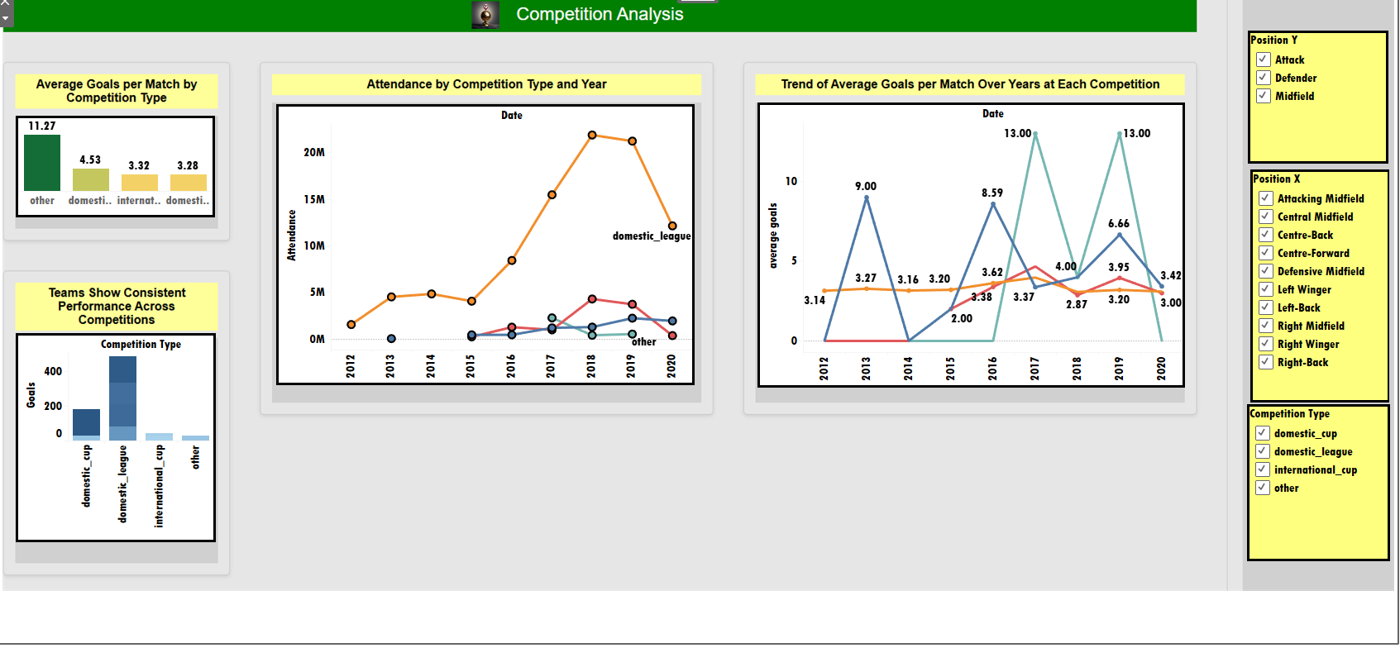
Core Objective 8: Competition Analysis
1.Descriptive analysis
Q)Which competitions (e.g., domestic vs. international) see the highest average goals per match? Ans : an unknown category competition maybe freindly tournament they have the highest average goals per match.
Q)How does trend in attendence and goals competition change over the season(year)
Ans: in domestic league consistently there is huge attendance
Q) Which teams show consistent performance across competitions?
Ans: broussia dortmund is consistent in each competition

Slide 20
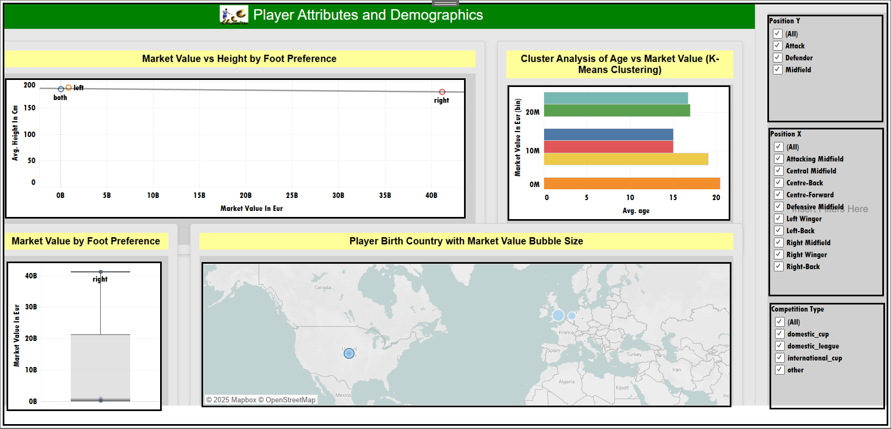
Core Objective 9: Player Attributes and Demographics
1.Descriptive analysis
Q) How do player attributes like age, height, foot preference, and position influence their market value across different competitions and countries? Ans right foot players don't have much average height but still leasds the race for market value rate.
cluster 2 apppears large despite generating no market value.Cluster 4 generates more market values.
right foot players leads the race of market value by miles by a lot compared to other foot player(left and both foot player)
Usa has the most players thus resulting in more market value by players.

Slide 21
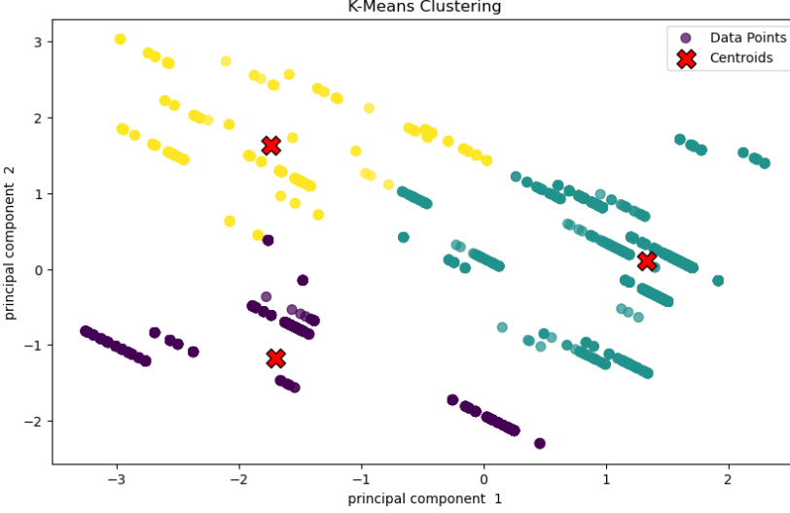
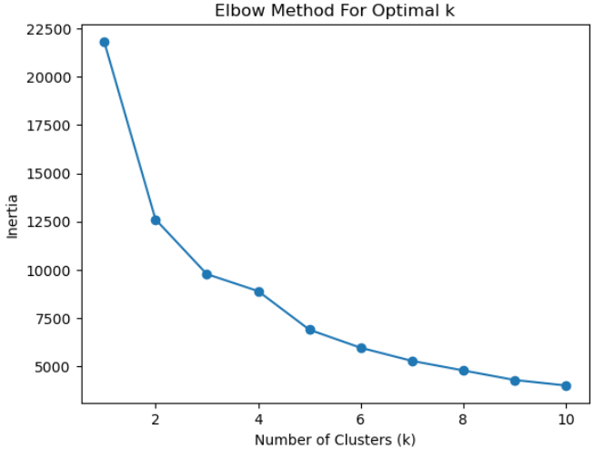
Core Objective 9: Player Attributes and Demographics Continue …………
2)K-means
Evaluation Metrics:
calinski_harabasz_score is 5816.9 so in general cases it is strong and well separated clusters .
0.68 is the davies_bouldin score shows that it is moderate clustering quality but miles behind poor nearer to excellent 0.5 so a average score. \
0.617 Shillouete score means clustering is good and well separated .
Q)Does player origin (country of birth) and physical attributes align with specific positional or performance clusters using K-means?
Optimal K :
k=3 is the elbow point(the point from which reduction becomes slower )
Scatter plot representation of K-Means Clustering:

Slide 22
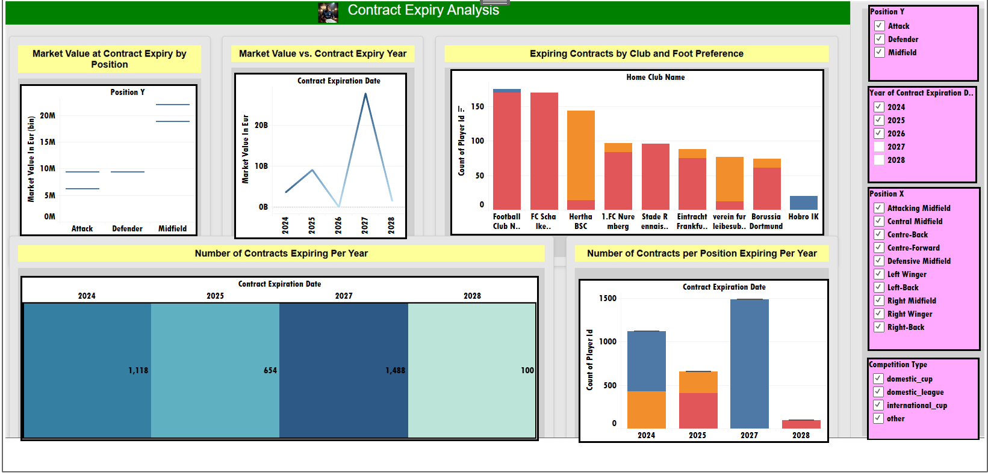
Core Objective 10:Contract Management
1.Descriptive analysis
Q) How do player positions, foot preference, and club affiliations influence the timing and market value of contract expirations,what patterns emerge in contract expiry trends over the years across different player roles?
Ans:
Midfielders have the highest market value at contract expiry.
2027 sees the highest number of expiring contracts (~1,488 players, mostly attackers).
Football Club Nords leads with 175 expiring contracts (170 right-footed, 5 left-footed).

Slide 23
Summary
Performance Analysis: Logistic Regression was not able to classify players as high or low performers using goal involvement and cards. So we shifted to KNN it gave good result. The Central Limit Theorem and Normal Distribution on minutes played revealed stamina trends.
Player Profile and Market Value: Simple and Multiple Linear Regression models predicted market value using goals, assists, age, and position. The best model was selected for accurate valuation.
Team Comparison: Z-tests on home and away club goals identified significant performance differences across teams.
Attendance and Stadium Analysis: KNN classification categorized matches as high or low attendance using home club, competition type, and date, aiding stadium management.
Referee Analysis: Tobias Stieler issued the most cards (25.48%). Referees with the most card-wise decisions gave no red cards. Card issuance(Yellow Card) increased from 2017-2020 compared to 2012-2017. Felix Zwayer officiated most in October.

Slide 24
Substitution Patterns: Game ID 4103556 had the most substitutions, mainly in the 70th-80th minute. Kasper Hjulmand made 130 substitutions, 73.85% not leading to goals.
Event Analysis: Goals, cards, and substitutions peaked in the second half. Attendance rose in the second half, with 85.03% staying (14.96% first half only).
Competition Analysis: An unknown competition had the highest average goals per match (11.37). Domestic leagues had higher attendance. Borussia Dortmund showed consistent performance.
Player Attributes and Demographics: Right-footed players had higher market value; height correlated weakly. Cluster 2 had the least value, Cluster 4 the most. The USA had the most high-value players.
Contract Management: Midfielders had the highest market value at contract expiry. In 2027, 1488 players’ contracts expire, mostly attackers (175 right-footed, 5 left-footed).

Slide 25
Conclusion
The analysis provides actionable insights across soccer analytics. Tobias Stieler and Felix Zwayer emerged as key referees, with disciplinary actions increasing over time. Substitutions, goals, and cards predominantly occur in the second half, suggesting teams adopt more aggressive strategies later in games.
Kasper Hjulmand’s frequent substitutions rarely led to goals, indicating a need for tactical refinement. Borussia Dortmund’s consistency across competitions highlights their reliability, while the unknown competition category’s high goal average warrants further investigation.
Player market value is driven by position (midfielders) and foot preference (right-footed), with the USA producing high-value players.
In 2027, a significant contract expiry wave, especially for attackers, offers opportunities for strategic recruitment.
Predictive models like Linear Regression, and KNN effectively classified player performance, market value, and attendance, while hypothesis testing confirmed performance disparities, enabling data-driven decisions for team management, stadium operations, and player valuation.

Slide 26
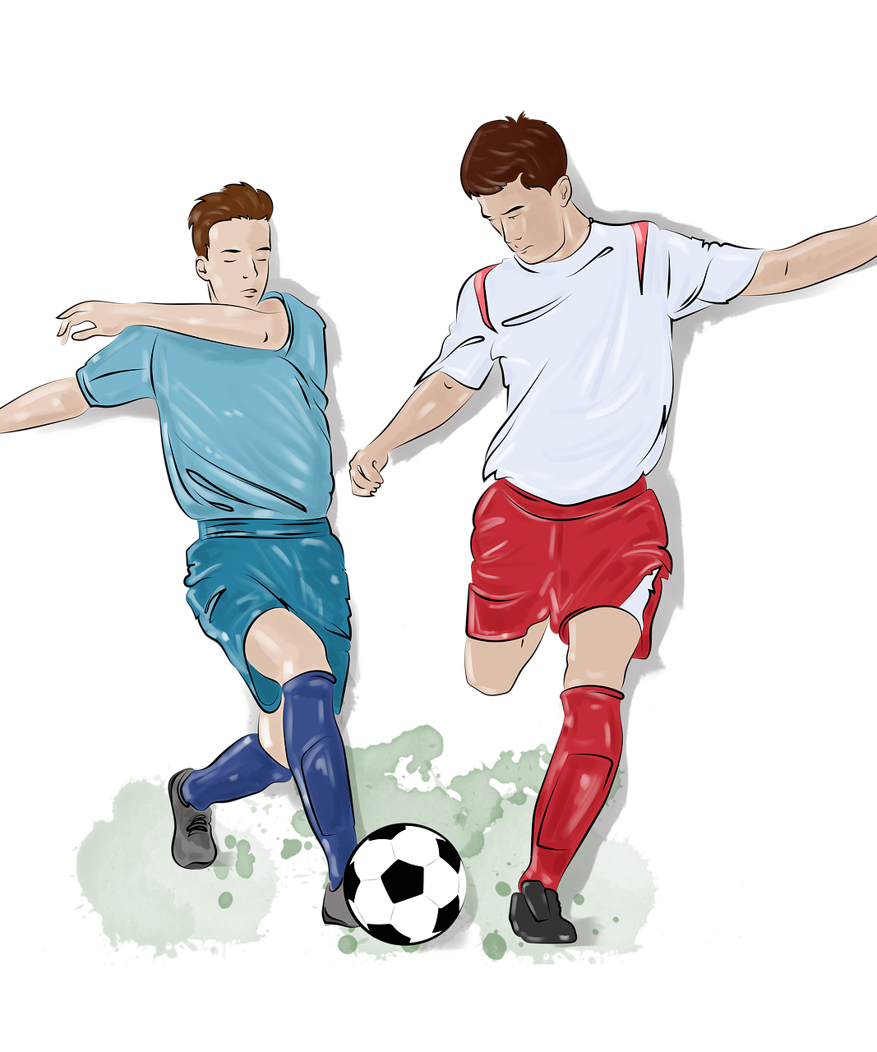
THANK YOU

